Slide 1
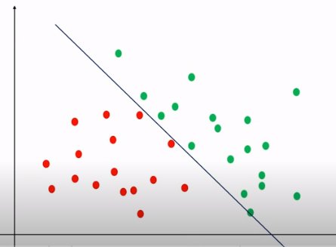
DECISION TREE
This type of data is easier to classify using logistic regression.

Slide 2
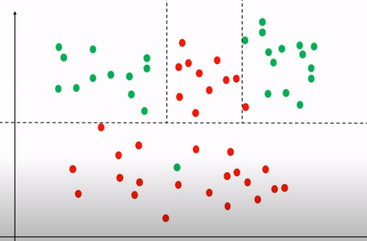
DECISION TREE
Complex datasets cannot be classified using single decision boundary.
We need to split dataset again and again to create multiple decision boundaries.
Decision tee helps to build that.

Slide 3
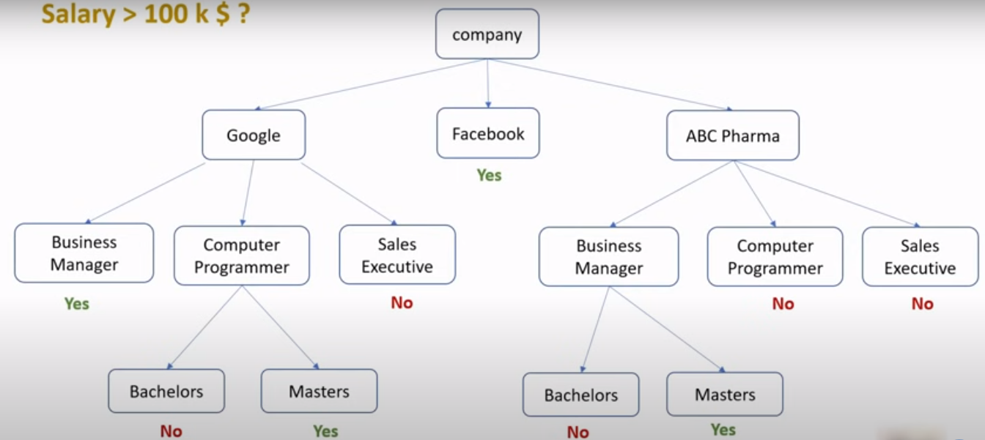
DECISION TREE
An example decision tree.

Slide 4
DECISION TREE
Humans can supply rules to logical reasoning programs
Another way is to impart the ability of constructing rules to the machines themselves.
The machine is given raw data and it is supposed to form rules (i.e. a model or concept) about the process from which the data is generated

Slide 5
DECISION TREES
Most widely used learning method
It is a method that induces concepts from examples
The learning is supervised: i.e. the classes or categories of the data instances are known
It represents concepts as decision trees, a representation that allows us to determine the classification of an object by testing its values for certain properties

Slide 6
DECISION TREES
We may think of each property of an instance as contributing a certain amount of information to its classification.
For example, if our goal is to determine the species of an animal, the discovery that it lays eggs contributes a certain amount of information to that goal

Slide 7
Definition
Decision tree is a classifier in the form of a tree structure
  Decision node: specifies a test on a single attribute
  Leaf node: indicates the value of the target attribute
  Arc/edge: split of one attribute
  Path: a disjunction of test to make the final decision
Decision trees classify instances or examples by starting at the root of the tree and moving through it until a leaf node.

Slide 8
Why decision tree?
Decision trees are powerful and popular tools for classification and prediction.
Decision trees represent rules, which can be understood by humans and used in knowledge system such as database.

Slide 9
key requirements
Attribute-value description: object or case must be expressible in terms of a fixed collection of properties or attributes (e.g., hot, mild, cold).
Predefined classes (target values): the target function has discrete output values (bollean or multiclass)
Sufficient data: enough training cases should be provided to learn the model.

Slide 10
Example – Average Disorder
Name | Hair | Height | Weight | Lotion | Result
Sarah | Blonde | Average | Light | No | Sunburned
Dana | Blonde | Tall | Average | Yes | None
Alex | Brown | Short | Average | Yes | None
Annie | Blonde | Short | Average | No | Sunburned
Emily | Red | Average | Heavy | No | Sunburned
Pete | Brown | Tall | Heavy | No | None
John | Brown | Average | Heavy | No | None
Katie | Blonde | Short | Light | Yes | None

Slide 11
Average Disorder
Average Disorder =
  ∑ Nb / Nt * (∑ - Nbc / Nb log2 Nbc / Nb)
  Where Nb is the number of samples in branch b,
  Nt is the total number of samples in all branches,
  Nbc is the total samples in branch b of class c

Slide 12
Example (cont.)
Attribute Name | Attribute Values | Attribute Occurrences
Hair | Blonde | 4
 | Brown | 3
 | Red | 1

Slide 13
Example (cont.)
Blonde = 4/8 (-2/4 log2 2/4 -2/4 log2 2/4)
= 4/8 (0.5 + 0.5)
= 0.5
Brown = 3/8 (-3/3 log2 3/3)
= 3/8 (-1 log2 1)
= 0
Red = 1/8 (-1 log2 1)
= 0

Slide 14
Example (cont.)
Average Disorder (Hair) = Blonde + Brown + Red
= 0.5 + 0 + 0
= 0.5
Average Disorder (Hair) = 0.5

Slide 15
Example (cont.)
Similarly Average Disorder for other attributes can be calculated; which turns out to be
Average Disorder (Hair) = 0.5
Average Disorder (Height) = 0.6886
Average Disorder (Weight) = 0.9386
Average Disorder (Lotion) = 0.6067

Slide 16
Example (cont.)
Most homogeneous attribute is Hair so put hair as the first test. Tree will be:
Hair
Blonde
Brown
Red

Slide 17
Example (cont.)
With red and brown hair color all the training set is completely classified. So the only problem left is with blonde hair color.
Attribute Name | Attribute Values | Attribute Occurrences
Height (with hair = blonde) | Tall | 1
 | Average | 1
 | Short | 2

Slide 18
Example (cont.)
Tall = 1/4 (-1 log2 1)
= 0
Average = 1/4 (-1 log2 1)
= 0
Short = 2/4 (-1/2 log2 1/2 -1/2 log2 1/2)
= 2/4 (0.5 + 0.5)
= 0.5
Average Disorder (Height with “hair = blonde”) = 0 + 0 + 0.5 = 0.5

Slide 19
Example (cont.)
Similarly for other attributes but with hair = blonde the average disorder is:
Average Disorder (Height with “hair = blonde”) = 0.5
Average Disorder (Weight with “hair = blonde”) = 1
Average Disorder (Lotion with “hair = blonde”) = 0

Slide 20
Example (cont.)
Here the lotion is with the minimum average disorder so it will be the nest test. Now the tree will become:
Hair
Blonde
Brown
Red
Lotion Used
No
Yes

Slide 21
Example (cont.)
Hair
Blonde
Brown
Red
Lotion Used
  Emily
Alex
Pete
John
Sun burn
No
Yes
No Sun burn
  Sarah
Annie
Dana
Katie
Sun burn
No Sun burn

Slide 22
Entropy
A measure of homogeneity of the set of examples.
Given a set S of positive and negative examples of some target concept (a 2-class problem), the entropy of set S relative to this binary classification is
E(S) = - p(P)log2 p(P) – p(N)log2 p(N)

Slide 23
Entropy
Suppose S has 25 examples, 15 positive and 10 negatives [15+, 10-]. Then the entropy of S relative to this classification is
E(S)=-(15/25) log2(15/25) - (10/25) log2 (10/25)

Slide 24
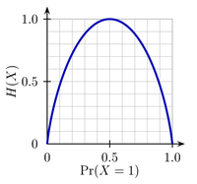
Some Intuitions
The entropy is 0 if the outcome is ``certain’’.
The entropy is maximum if we have no knowledge of the system (or any outcome is equally possible).
Entropy of a 2-class problem with regard to the portion of one of the two groups

Slide 25
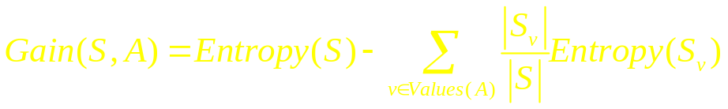
Information Gain
Information gain measures the expected reduction in entropy, or uncertainty.
  Values(A) is the set of all possible values for attribute A, and Sv the subset of S for which attribute A has value v Sv = {s in S | A(s) = v}.
  the first term in the equation for Gain is just the entropy of the original collection S
  the second term is the expected value of the entropy after S is partitioned using attribute A

Slide 26
Information Gain
It is simply the expected reduction in entropy caused by partitioning the examples according to this attribute.
It is the number of bits saved when encoding the target value of an arbitrary member of S, by knowing the value of attribute A.

Slide 27
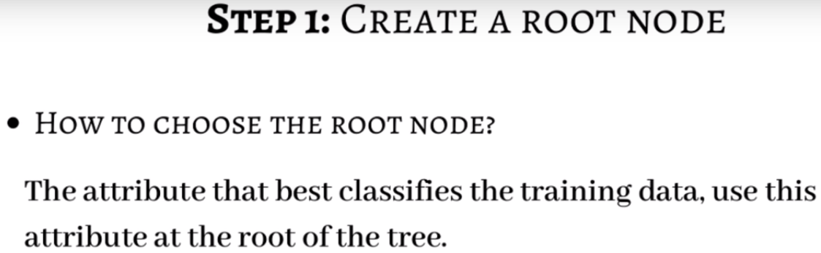

Slide 28
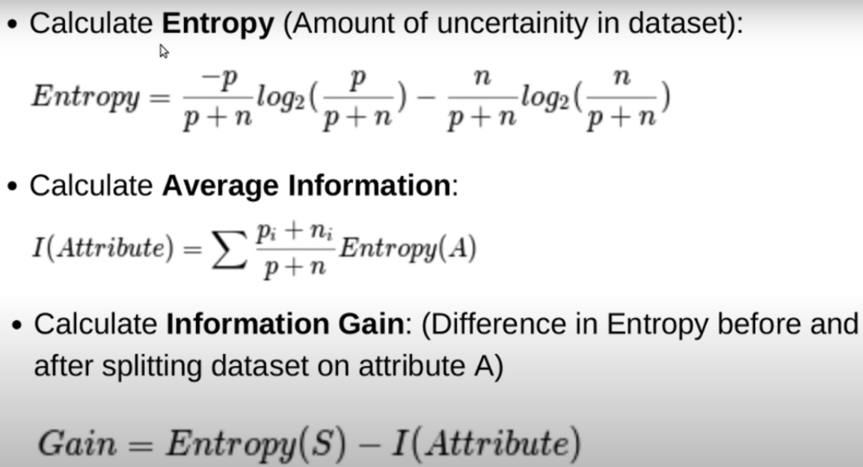

Slide 29
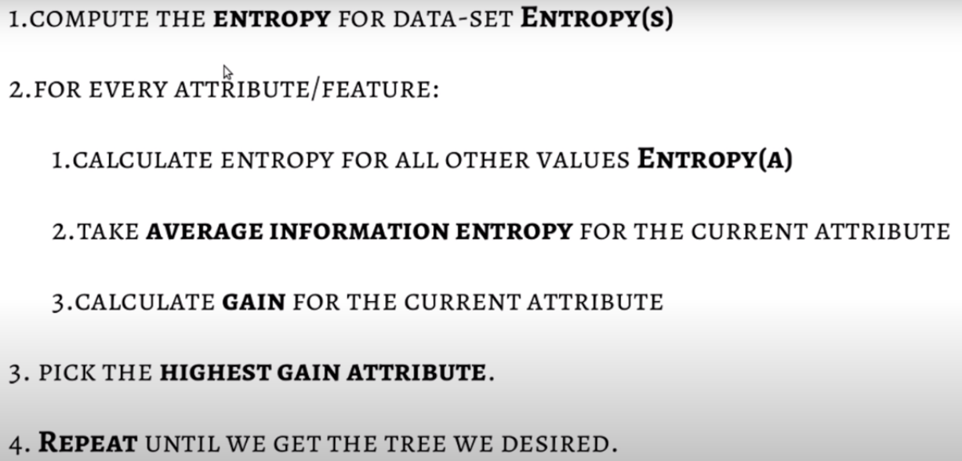

Slide 30
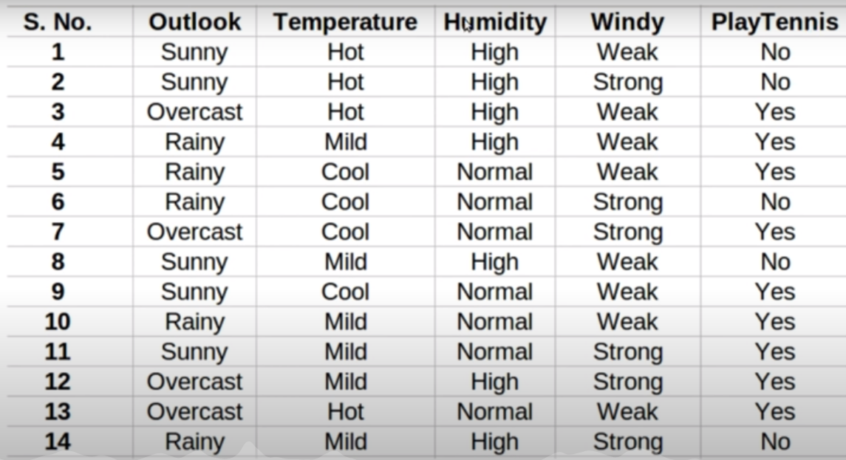
Example – Entropy/ I.G.

Slide 31
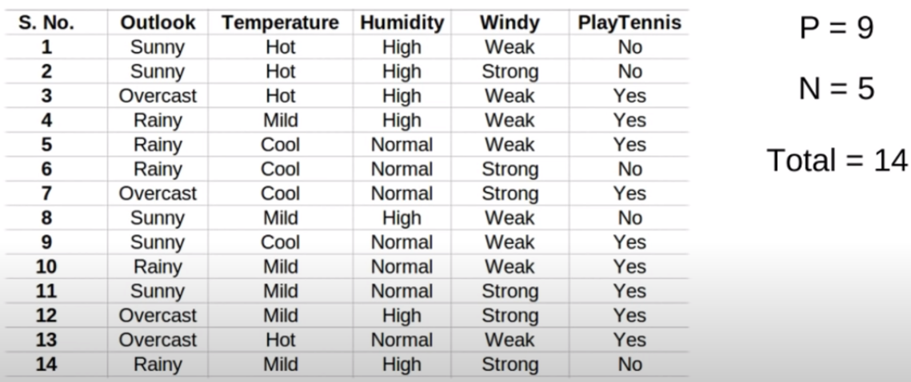
Example – Entropy/ I.G.

Slide 32
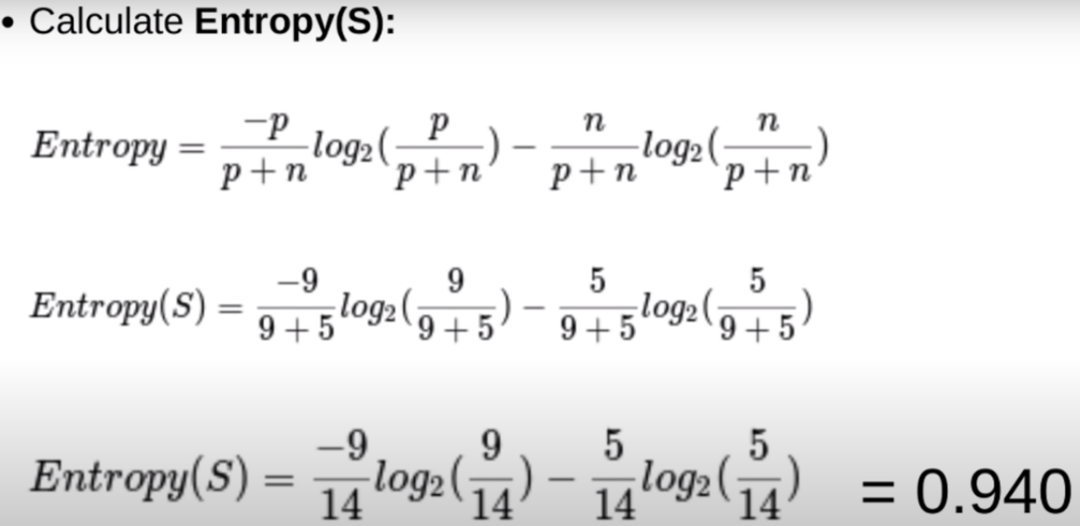
Example – Entropy/ I.G.

Slide 33
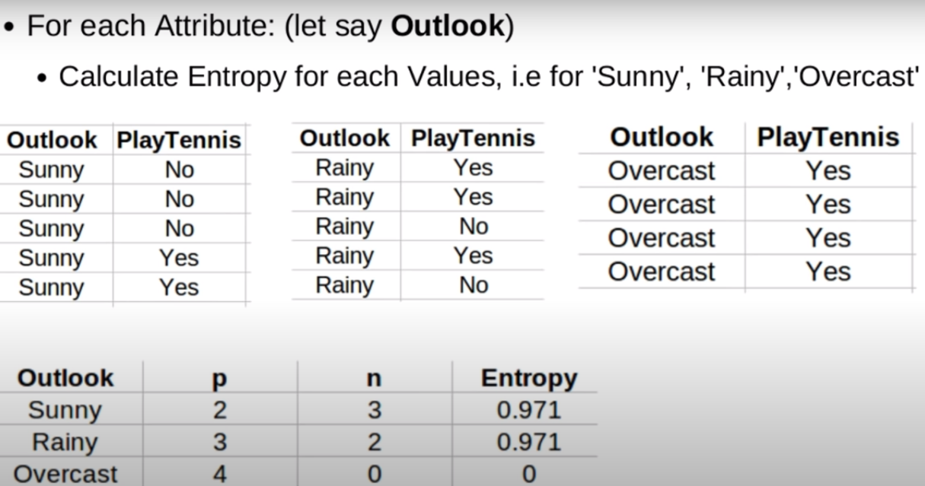
Example – Entropy/ I.G.

Slide 34
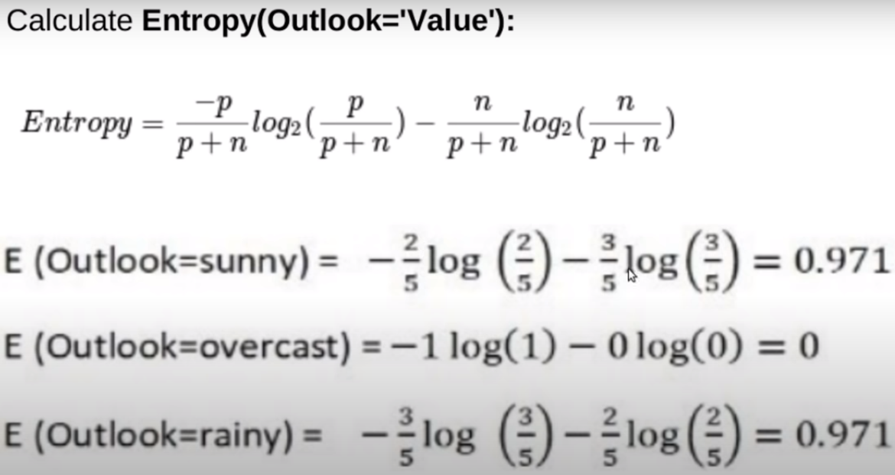
Example – Entropy/ I.G.

Slide 35
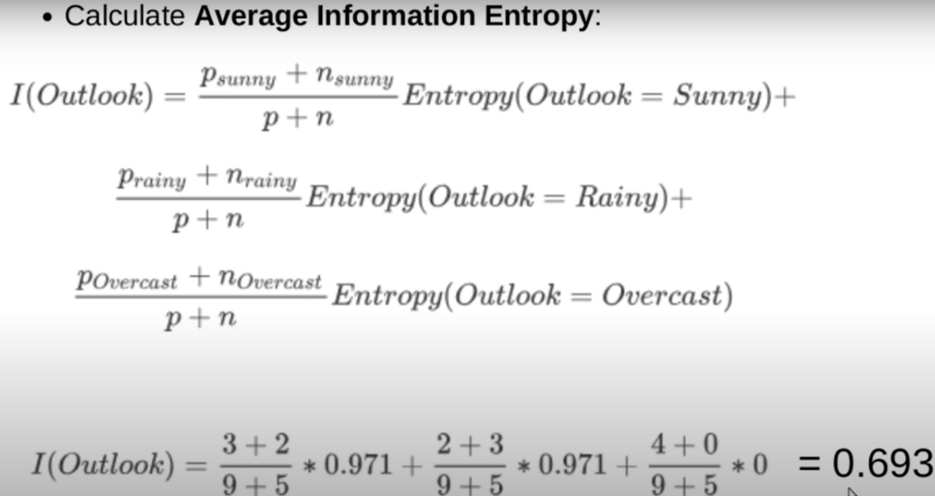
Example – Entropy/ I.G.

Slide 36
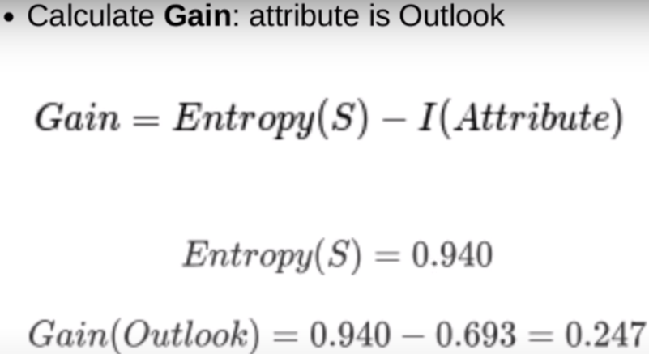
Example – Entropy/ I.G.

Slide 37
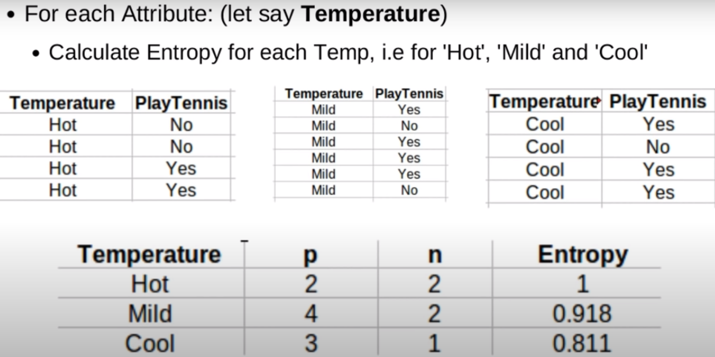
Example – Entropy/ I.G.

Slide 38
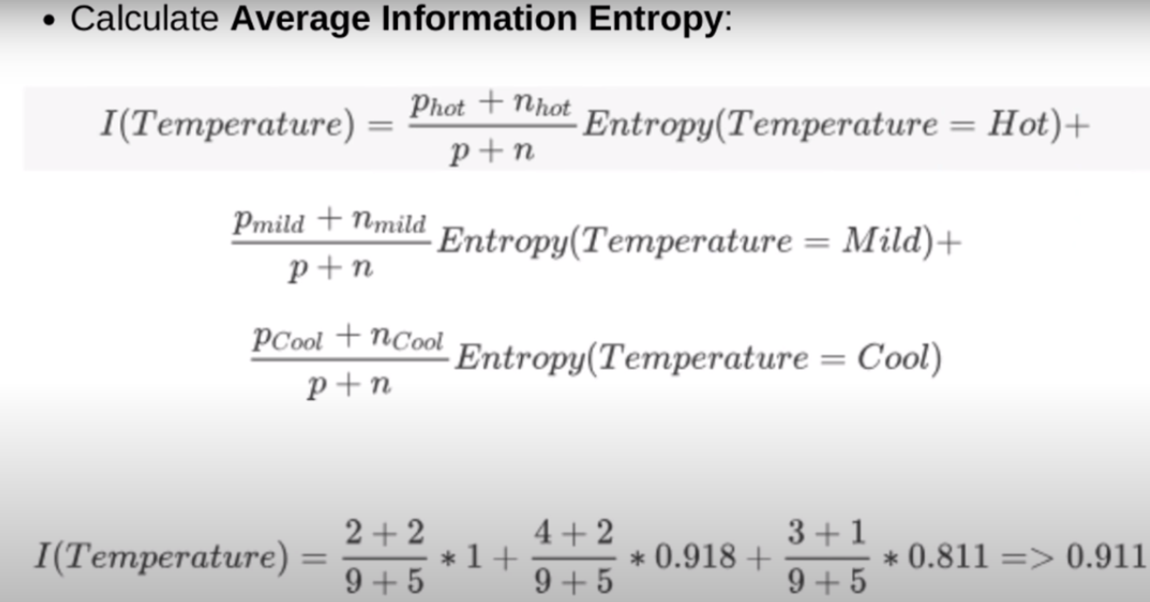
Example – Entropy/ I.G.

Slide 39
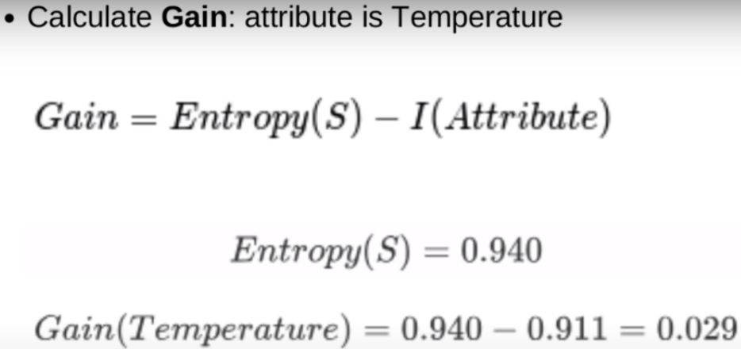
Example – Entropy/ I.G.

Slide 40
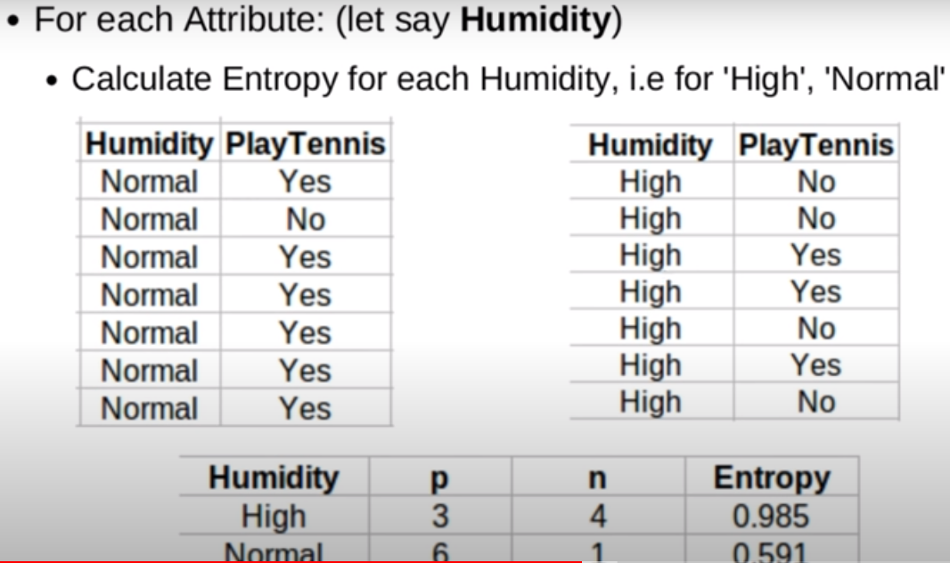
Example – Entropy/ I.G.

Slide 41
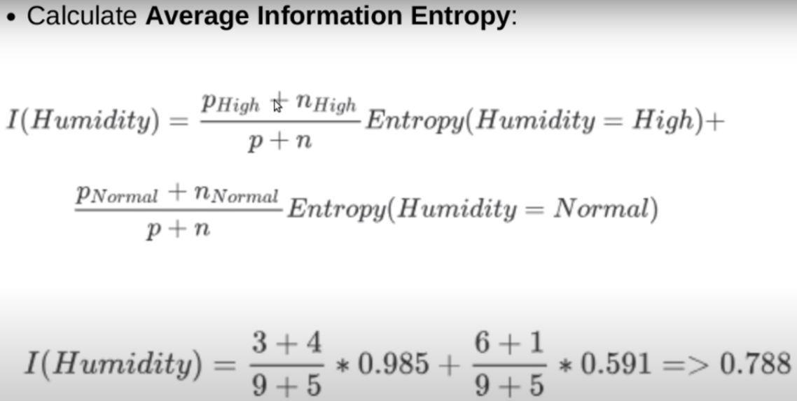
Example – Entropy/ I.G.

Slide 42
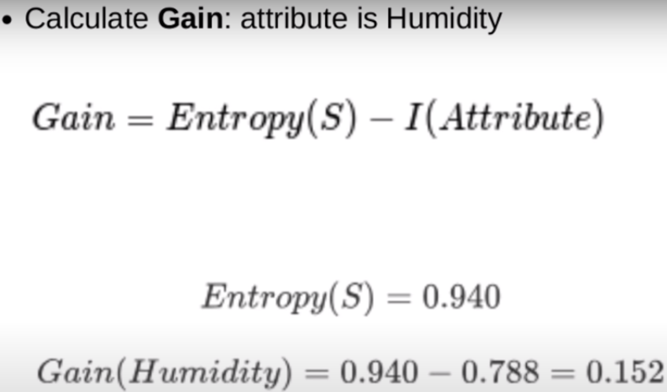
Example – Entropy/ I.G.

Slide 43
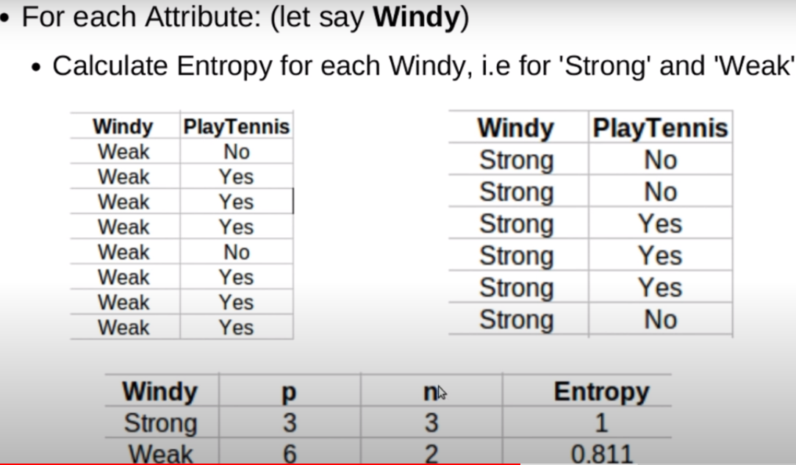
Example – Entropy/ I.G.

Slide 44
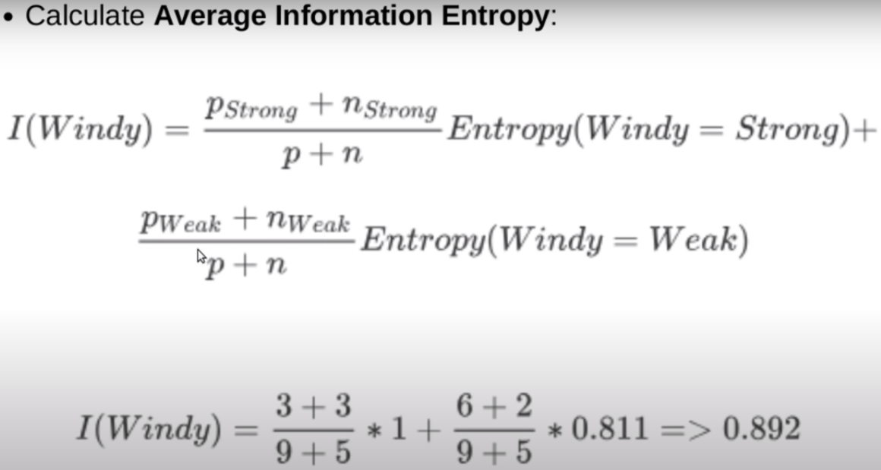
Example – Entropy/ I.G.

Slide 45
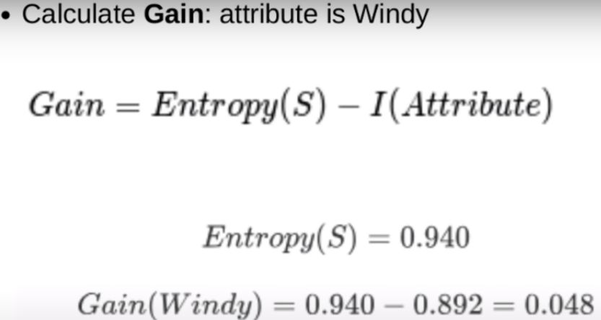
Example – Entropy/ I.G.

Slide 46
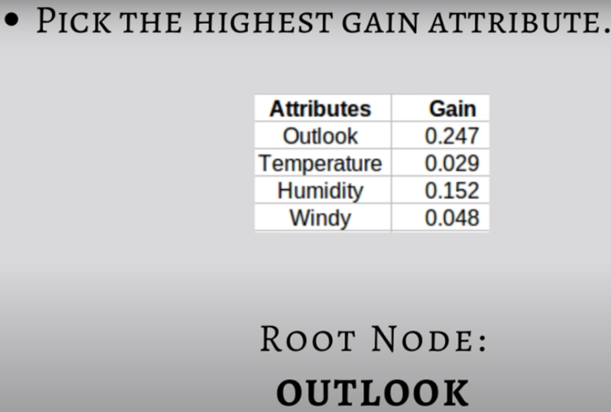
Example – Entropy/ I.G.

Slide 47
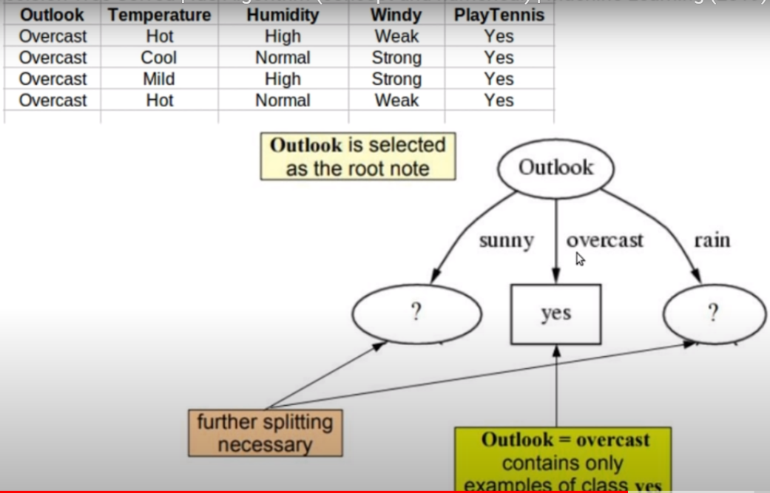
Example – Entropy/ I.G.

Slide 48
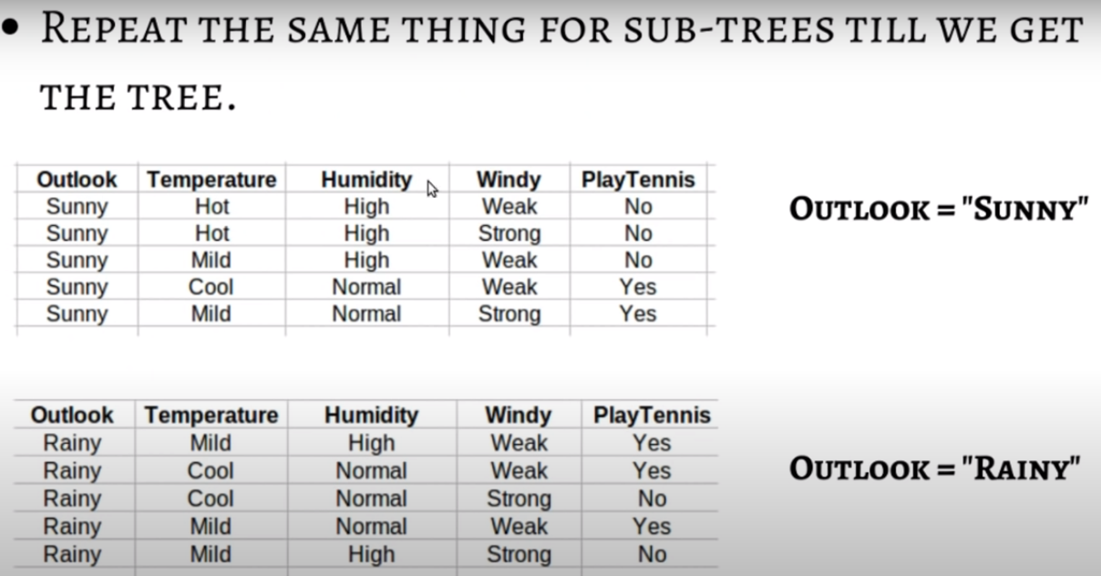
Example – Entropy/ I.G.

Slide 49
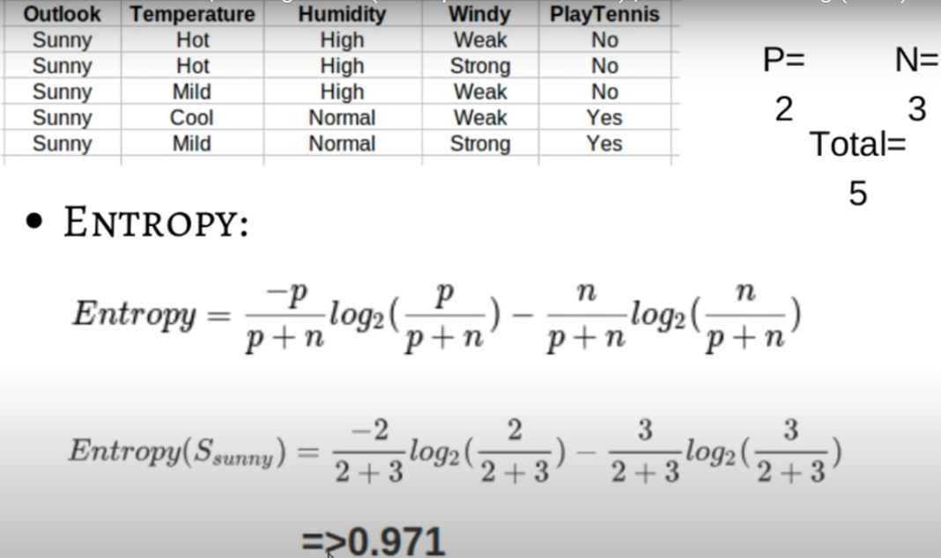
Example – Entropy/ I.G.

Slide 50
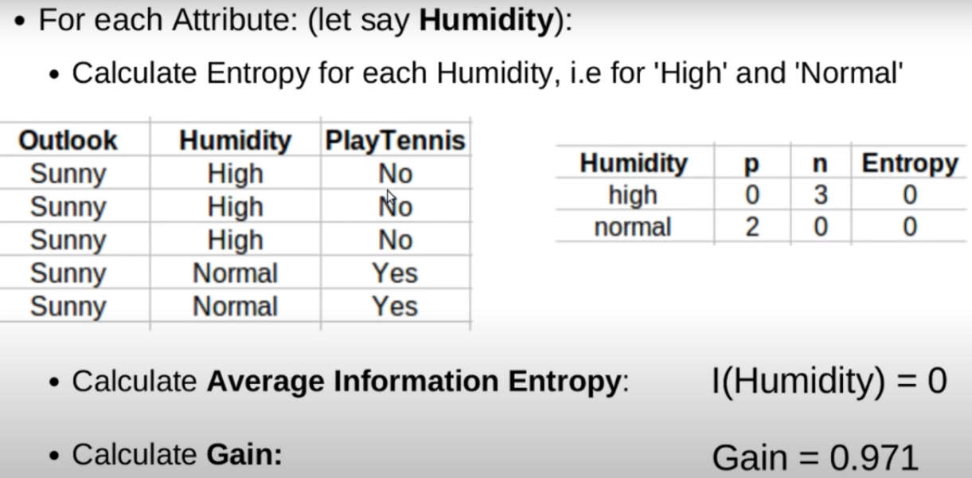
Example – Entropy/ I.G.

Slide 51
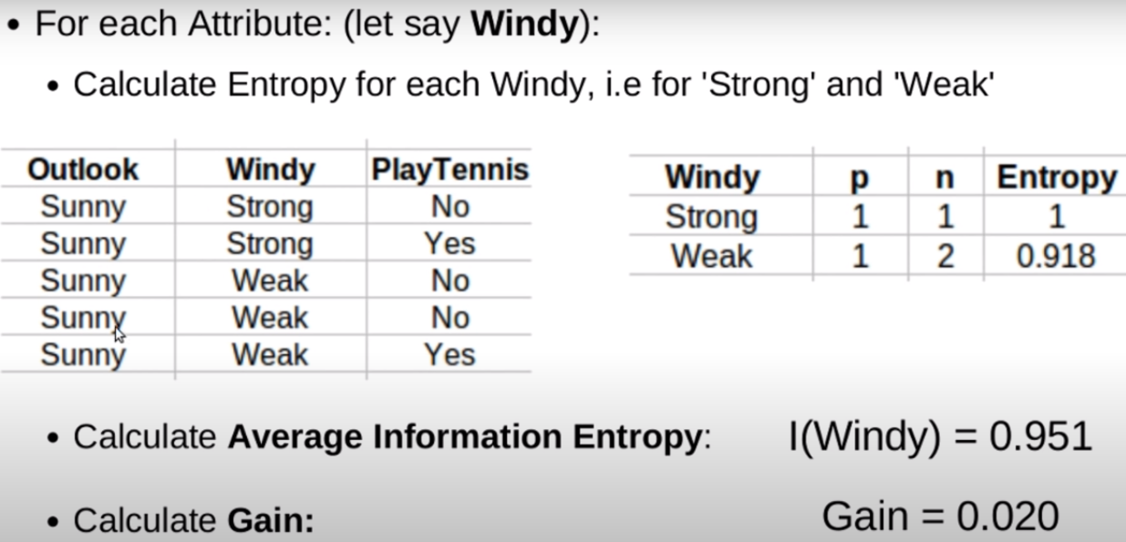
Example – Entropy/ I.G.

Slide 52
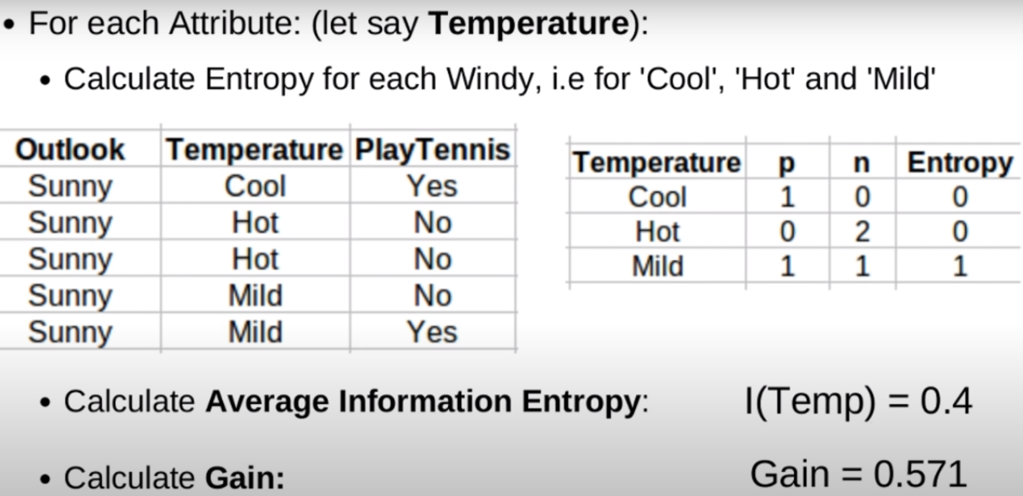
Example – Entropy/ I.G.

Slide 53
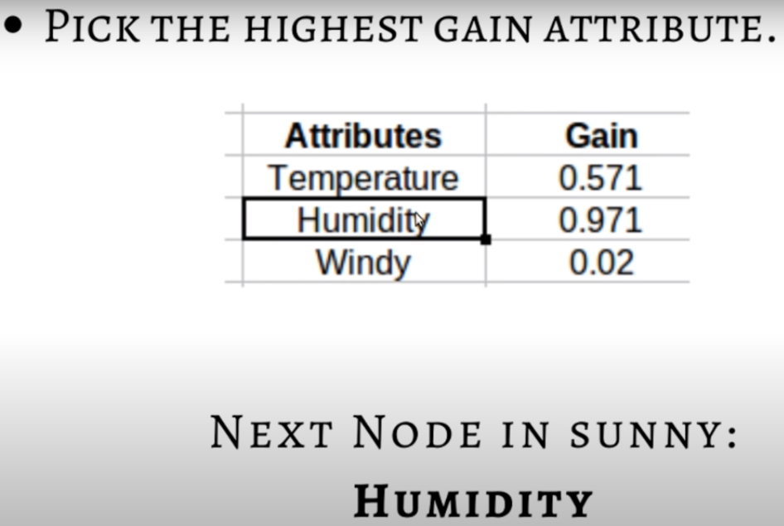
Example – Entropy/ I.G.

Slide 54
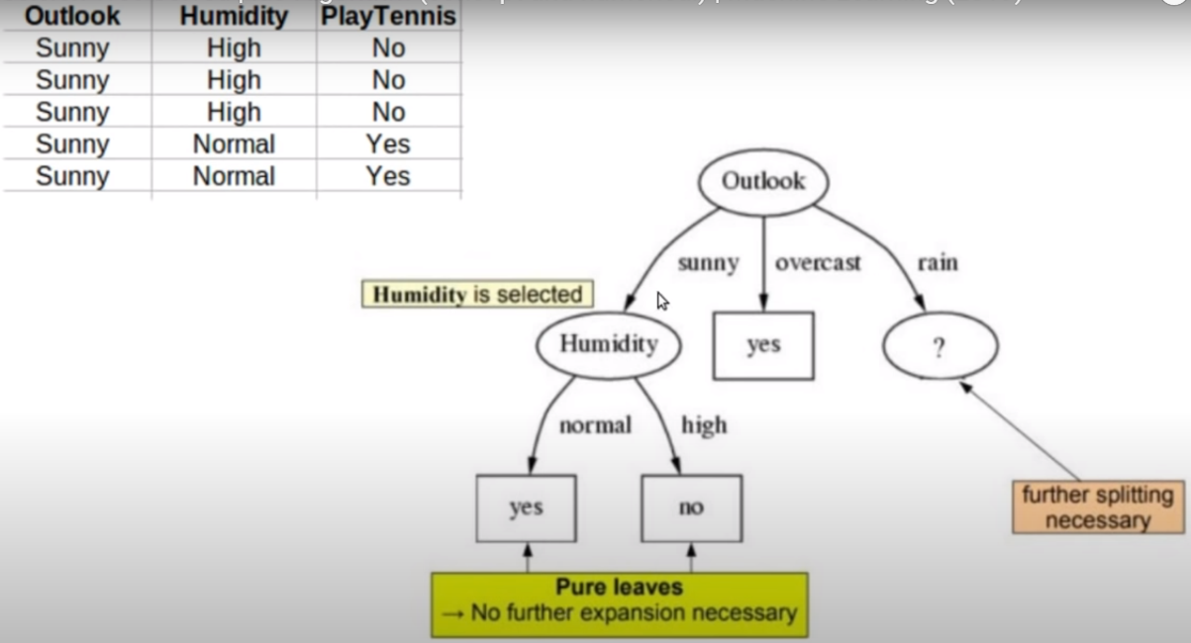
Example – Entropy/ I.G.

Slide 55
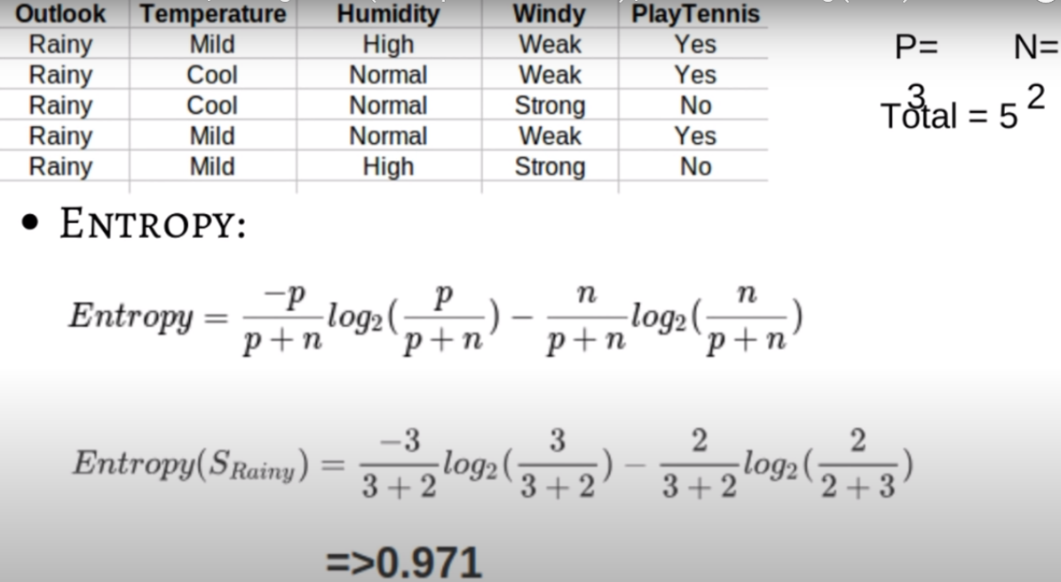
Example – Entropy/ I.G.

Slide 56
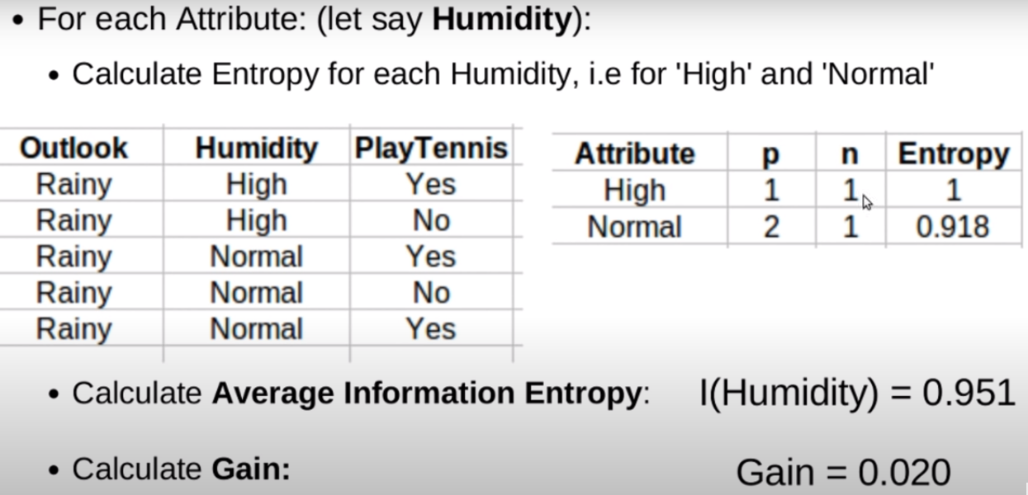
Example – Entropy/ I.G.

Slide 57
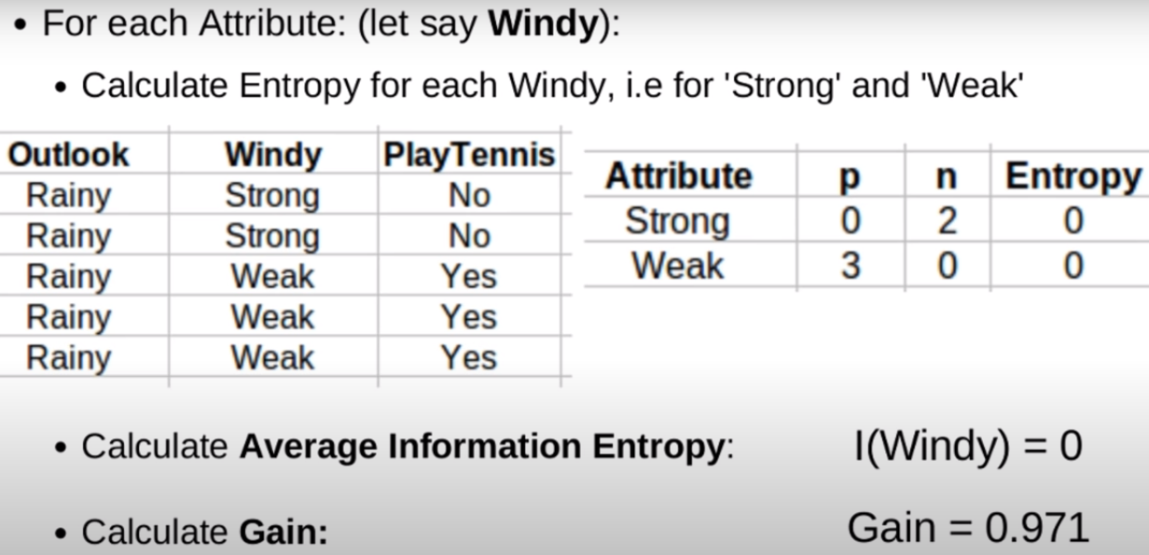
Example – Entropy/ I.G.

Slide 58
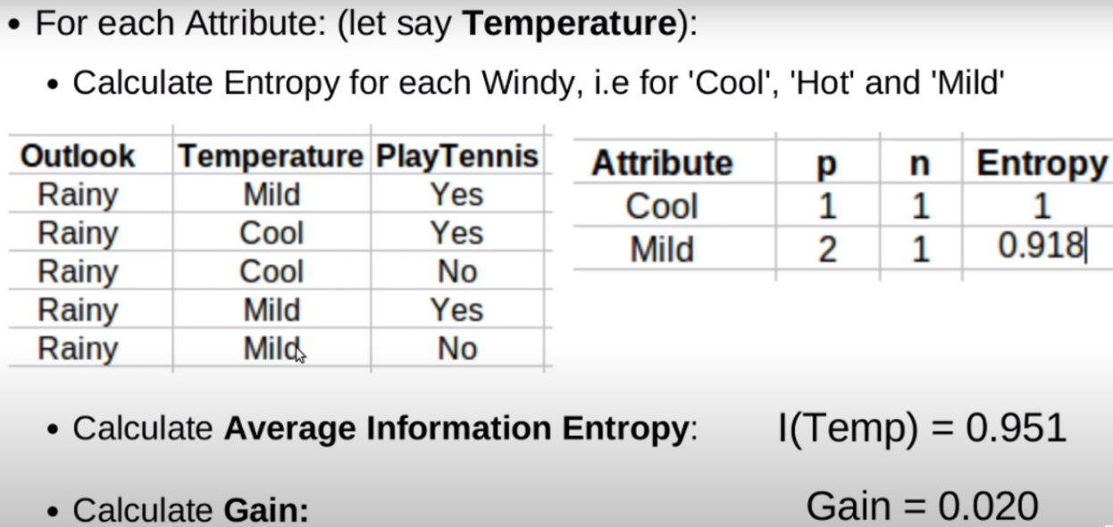
Example – Entropy/ I.G.

Slide 59
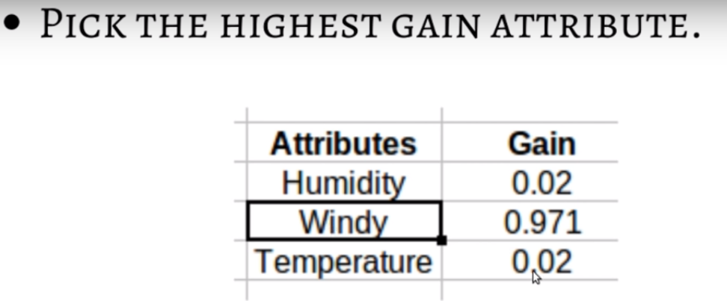
Example – Entropy/ I.G.

Slide 60
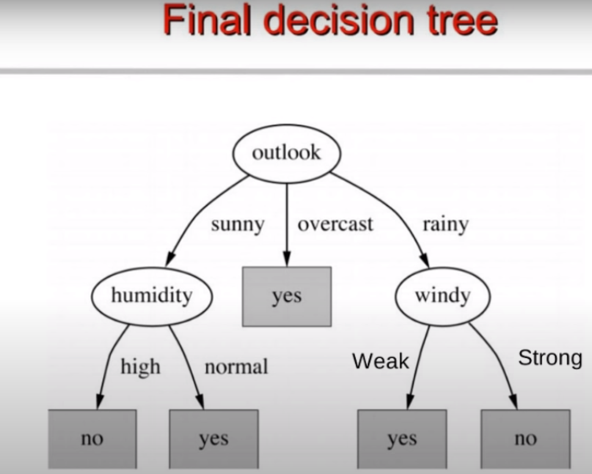
Example – Entropy/ I.G.

Slide 61
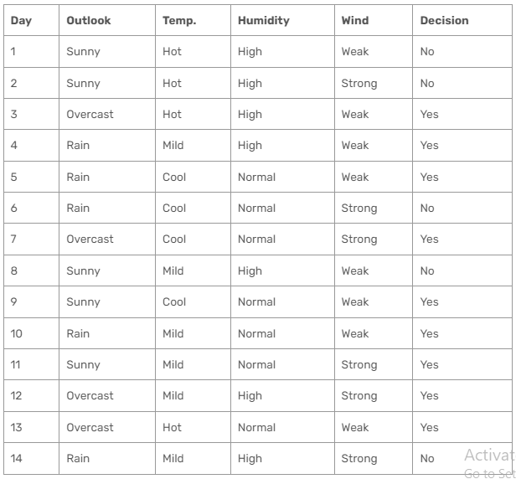
Gini Index - Example

Slide 62
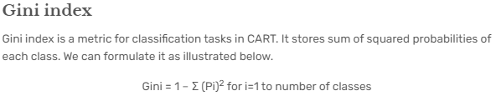

Slide 63
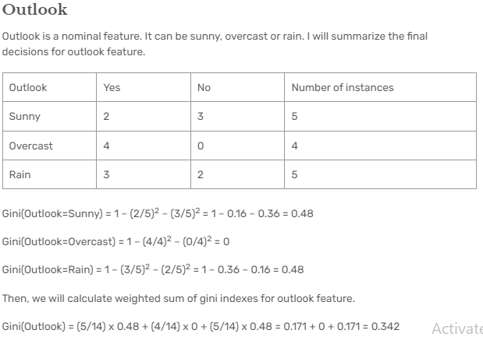

Slide 64
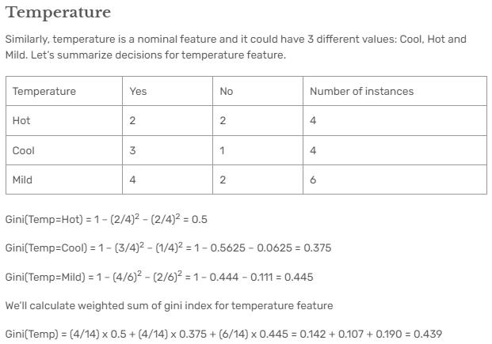

Slide 65
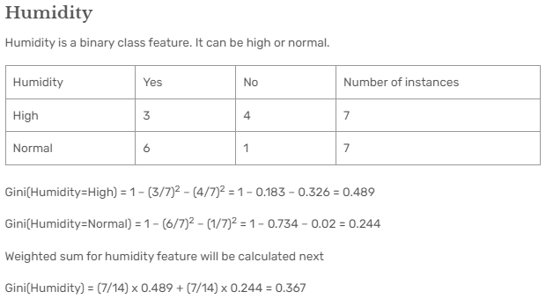

Slide 66
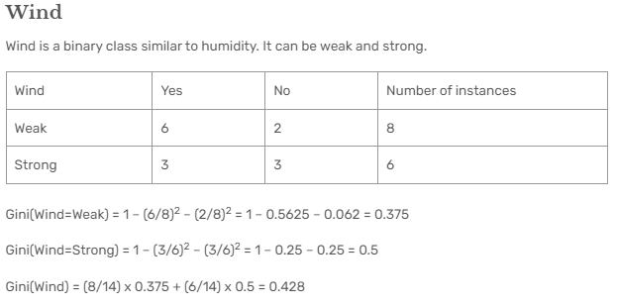

Slide 67
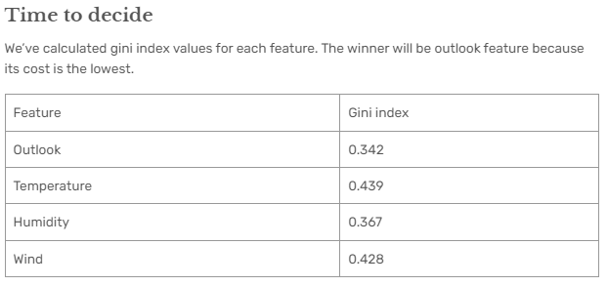

Slide 68
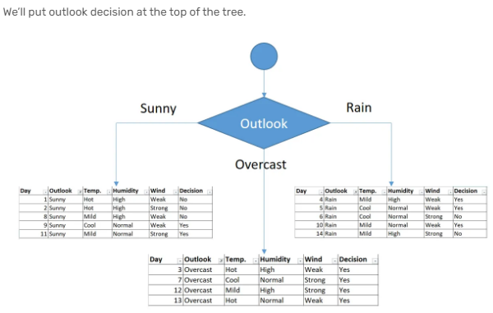

Slide 69
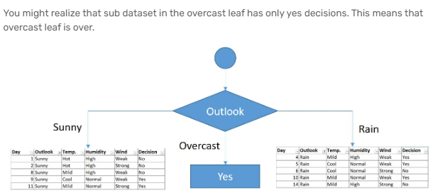

Slide 70
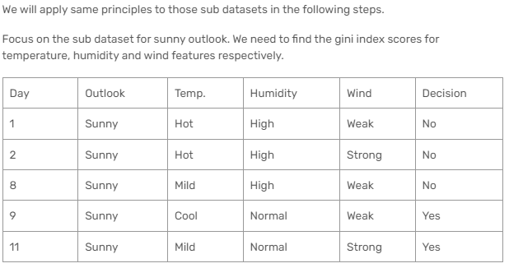

Slide 71
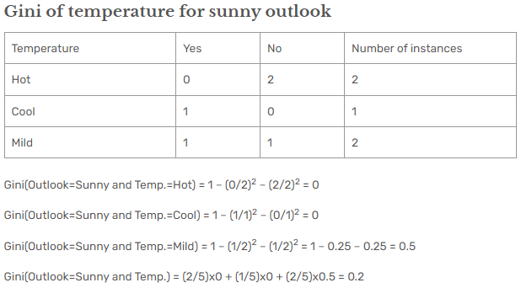

Slide 72


Slide 73


Slide 74


Slide 75


Slide 76


Slide 77


Slide 78


Slide 79


Slide 80


Slide 81


Slide 82


Slide 83


Slide 84
From Decision Trees to Rules

Slide 85
DECISION TREES
From Decision Trees to Rules
Hair
Blonde
Brown
Red
Lotion Used
  Emily
Alex
Pete
John
Sun burn
No
Yes
No Sun burn
  Sarah
Annie
Dana
Katie
Sun burn
No Sun burn

Slide 86


IDENTIFICATION TREES
From Decision Trees to Rules
Step 3: Make rules from the identification tree
For our example we have:
If the person’s hair is blonde
and the person uses lotion
then the person is not sunburned
If the person’s hair is blonde
and the person uses no lotion
then the person is sunburned

Slide 87
IDENTIFICATION TREES
From Decision Trees to Rules
Step 3: Make rules from the identification tree
For our example we have:
If the person’s hair is red
then the person is sunburned
If the person’s hair is brown
then the person is not sunburned

Slide 88
IDENTIFICATION TREES
From Decision Trees to Rules
Step 4: Optimize the rules (prune the antecedents)
To simplify a rule, you ask whether any of the antecedents can be eliminated without changing what the rule does on the samples
Example:
If hair is blonde and person uses lotion then no sunburn
If we eliminate the 1st antecedent, and check the rule over the whole database, we find that there are no misclassifications
Hence we can drop this antecedent as unnecessary

Slide 89
IDENTIFICATION TREES
From Decision Trees to Rules
Step 4: Optimize the rules (prune the antecedents)
Example:
If hair is blonde and person uses lotion then no sunburn
If we eliminate the 1st antecedent, and check the rule over the whole database, we find that there are no misclassifications
Hence we can drop this antecedent as unnecessary

Slide 90
IDENTIFICATION TREES
From Decision Trees to Rules
Step 4: Optimize the rules (prune the antecedents)
Example:
If hair is blonde and person uses lotion then no sunburn
If we eliminate the 2nd antecedent then the resulting shortened rule is not consistent with the data, hence it cannot be eliminated

Slide 91
IDENTIFICATION TREES
From Decision Trees to Rules
Step 4: Optimize the rules (eliminate unnecessary rules)
Rules leading to one label can be replaced by a default rule:
If no other rule applies
then label x
However, this means a very big assumption that all of the uncovered concept space belongs to label x
This may mean a misclassification of an unknown instance

Slide 92
Strengths
can generate understandable rules
perform classification without much computation
can handle continuous and categorical variables
provide a clear indication of which fields are most important for prediction or classification

Slide 93
Weakness
Not suitable for prediction of continuous attribute.
Perform poorly with many class and small data.
Computationally expensive to train.
  At each node, each candidate splitting field must be sorted before its best split can be found.
  In some algorithms, combinations of fields are used and a search must be made for optimal combining weights.
  Pruning algorithms can also be expensive since many candidate sub-trees must be formed and compared.
Do not treat well non-rectangular regions.

